Slide 1
Improving Employer and Member Experience though Analytics
Amy Bloedorn
Senior Director, Data Analytics

Slide 2
Agenda
Introduction
New Analytics Dashboard: CoreInsights
Data Analytics Strategy

Slide 3
New Analytics Dashboards: CoreInsights

Slide 4
What is CoreInsights?
CoreInsights provides analytics, reporting and key insights, summarized into easy-to-use, self-service dashboards that help employers stay informed and make smart choices about their health plan
CoreInsights uses 27 months of data and the system is refreshed each month with the latest medical, pharmacy, eligibility, HRA and biometric information (when available)
Employers can analyze data related to membership, utilization, providers and have the ability to customize their dashboards and drill-down. CoreInsights includes 6 dashboards:
Executive Summary
Population Overview
Medical Cost Drivers
Pharmacy Cost Drivers
Financial Analysis Panel
Health Management Panel

Slide 5
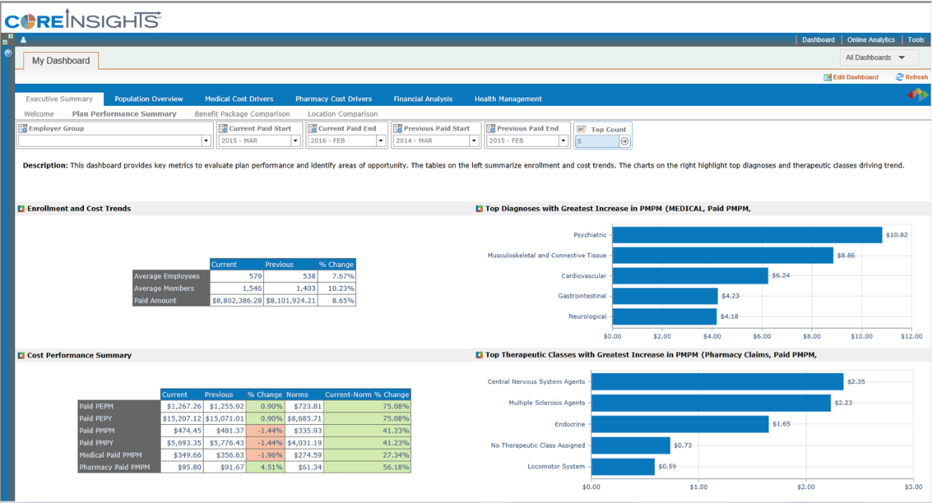
Executive Summary Dashboard
The Executive Summary Dashboard displays information about the group membership and plan performance, including top procedures, benefit package and location comparisons. This dashboard can be used to quickly see key metrics to evaluate plan performance and identify areas of opportunity.
How is my behavioral health program?
How is my membership and cost trending?
Could some of the spike be workplace related?

Slide 6
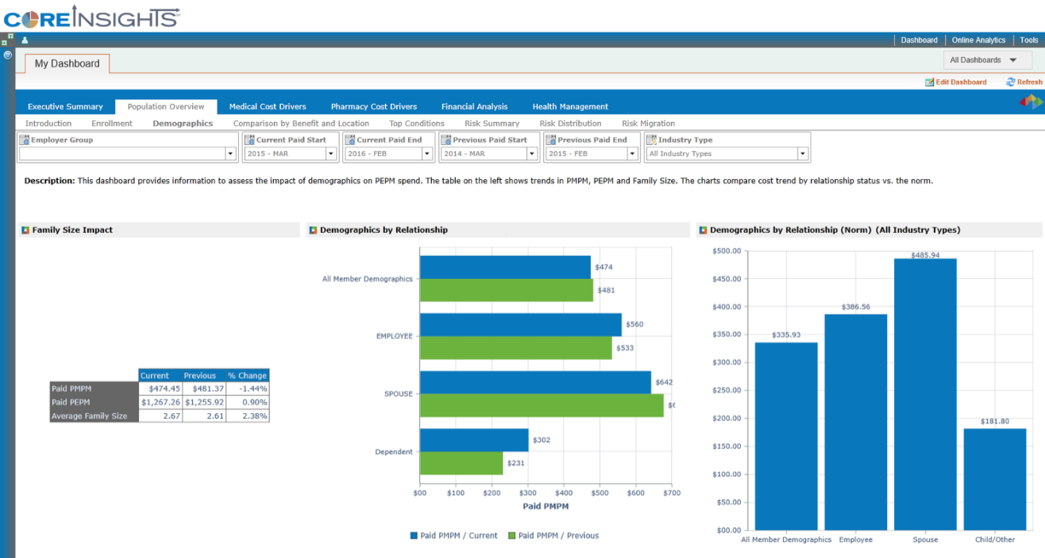
Population Overview Dashboard
The Population Overview Dashboard describes the population’s demographics in relation to benchmarks. The section will provide a better understanding of the plan’s cost and highlight the potential for risk including top conditions for the population.
Our costs are higher than the norm. How do we change our plan design or programs to make employees and particularly, spouses, more engaged in their healthcare decisions?

Slide 7
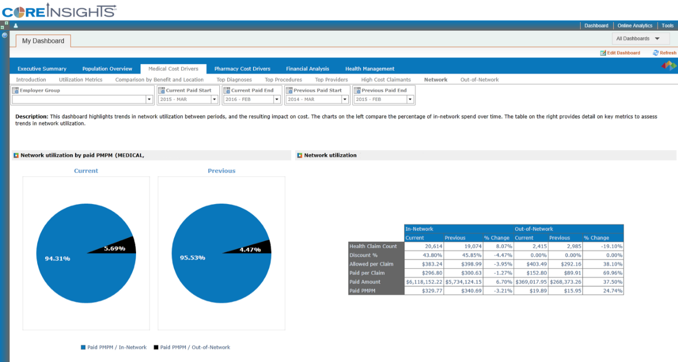
Medical Cost Drivers Dashboard
The Medical Cost Drivers Dashboard compares medical costs to the norm and highlights key trend drivers by plan, division, diagnosis, procedures, providers, high cost claimants, network utilization. This section can help shape plan design and influence potential wellness programs or other solutions to help control future medical costs.
What’s driving my decrease in network utilization? Is there an accessibility issue?
More claims but fewer dollars are being spent in network partially due to discount erosion

Slide 8
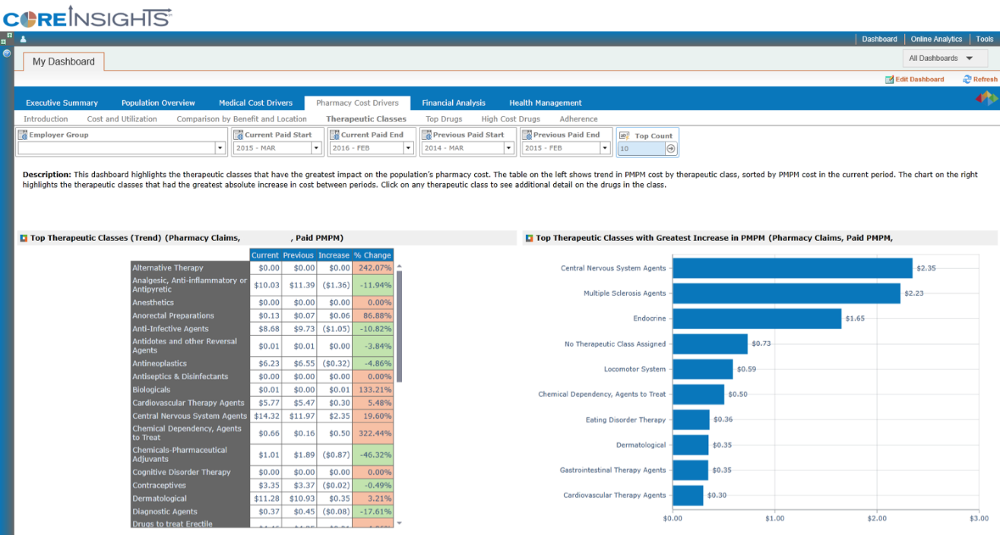
Pharmacy Cost Drivers Dashboard
The Pharmacy Cost Drivers Dashboard compares pharmacy costs to the norm and highlights key trend drivers including by; plan & division, therapeutic class, specific drug, and medication adherence opportunities. This section will help you understand how simple pharmacy changes such as mail order instead of retail or switching to generics instead of brand name drugs could lead to significant savings.
What’s driving the increase? Do I have opportunities to create awareness around generic or mail order utilization?

Slide 9
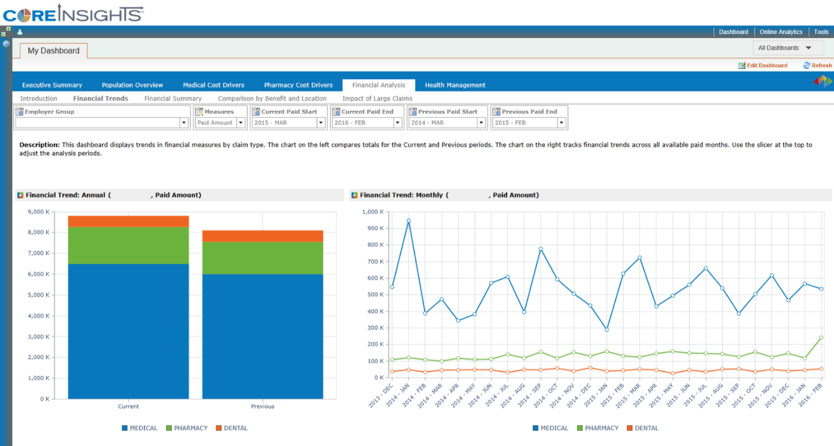
Financial Analysis Dashboard
The Financial Analysis Dashboard shows trends in financial measures using a variety of metrics. This section will provide insight into which types of claims (medical, pharmacy and dental) are costing the most, identify the impact of claim severity and identify potential areas for savings.
Dental has been consistent, but Medical and Rx increased from PYTD and Rx spiked last month. Has there been a change in the payment process or is utilization driving the spike?

Slide 10
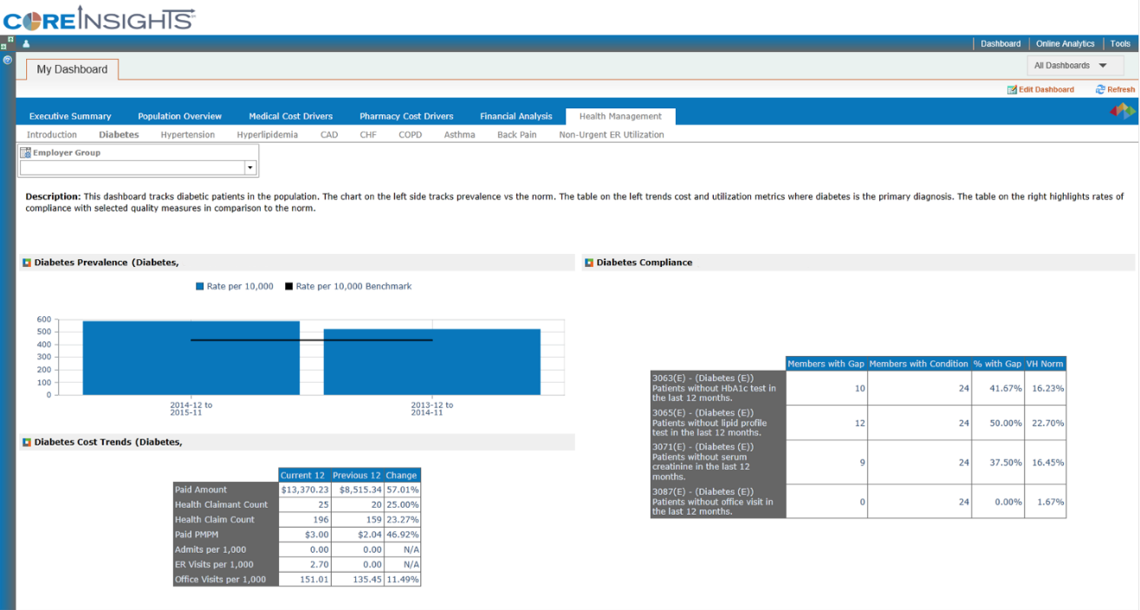
Health Management Dashboard
The Health Management Dashboard tracks the impact of chronic disease such as; diabetes, hypertension, hyperlipidemia, CAD, CHF, COPD, Back Pain and Asthma on the population. This section summarizes trends in prevalence, cost, non-urgent ER utilization as well as compliance with evidence based care procedures.
My population’s diabetes rate is above the norm and increased from PYTD. ER visits increased and my members have more gaps in care than the norm. What can I do to improve compliance, member health and costs?

Slide 11
Data Analytics Strategy

Slide 12
Improving Delivery of Insights and Proactive Advisory Services
Reporting & Data Analytics that are Simple and Insightful
Data-mining to identify 2-3 client specific cost drivers pulled together into a concise dashboard
Corresponding recommendations of appropriate programs and products to drive employee engagement and reduce cost
Ongoing tracking to measure program impact and ROI over time

Slide 13
Current Model Uses Data and Clinical Expertise to Identify Populations and Individuals at Risk
Outcomes: Reduced Claim Expense, Improved Patient Compliance, Informed Employers
Knowledge: Risk Indexing, Normative Comparisons, Clinical Compliance
Information: Data Warehouse
Data: Clinical Transactions/Claims, Eligibility Files, Self-Reported Data from HRAs & Biometrics, Benchmarks
Action: Data driven employer solutions, Potential for clinical intervention though gaps in care
Claim
HRA, Wellness, Biometric
External Benchmarks
Current
Data Sources
Eligibility &
Demographic

Slide 14
Future-State Model Leverages Data and Clinical Expertise with a Risk Model to Identify Adverse Surprises before they Occur and Throughout the Member Life-Cycle to Improve Financial and Quality Outcomes
Outcomes: Reduced Claim Expense, Improved Quality, Informed Consumer Decision-Making
Knowledge: Risk and Predictive Modeling
Information: Data Warehouse
Data: Clinical Transactions, Eligibility Files, Electronic Medical Records, Self-Reported Data, Benchmarks, Patient Satisfaction, Provider Quality
Action: Clinical Best Practices, Customer Specific-Risk Alerts, Consumer Insights on Shop-able Services, Stewardship
Claim
HRA, Wellness, Biometric, Activity Tracking
Clinical/EMR
Quality and Outcomes
Patient & Member Satisfaction
Eligibility & Demographic
External Benchmarks
Integrated Data Sources
Notes:
Demonstrated risk modeling allows you to defer clinical intervention until risk is evident as patients mature: medical and pharmacy utilization, provider historical performance, appropriateness of care indicators, surgical predictors, co-morbid conditions, external benchmarks, HRA, demographic and socioeconomic data

